Slide 1
Analysis of twitter data using Spark,Hive and Solr
Jagadheesh Maroju
Sai Prasad Raju
Praveen Poluri
Paul Gomes

Slide 2
ABSTRACT
The main idea is to do the ETL process using Spark and implementing the graphframe concepts on this real-time data. We got useful insights and plot them in visualizations.
The source of our system is Twitter data collected using twitter stream API in python
Loaded the data into HDFS and performed queries in the Hive system which is like basic ETL process.
Created data frame in spark and got some useful insights by performing queries in spark. Plotted visualizations
Performed transitions in solr.
Created a graph frame using Spark graph frame API and performed various operations.

Slide 3
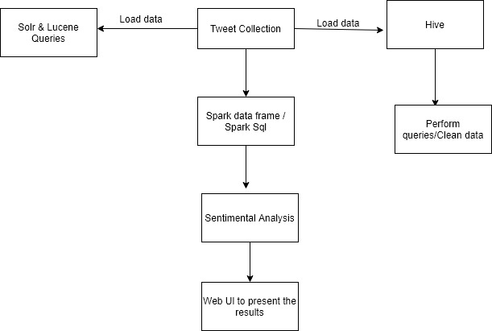
PROJECT FLOW

Slide 4
Hive operations:
Imported the twitter data file into HDFS
Created table in Hive and loaded the HDFS data into the created table
Performed different queries in hive

Slide 5

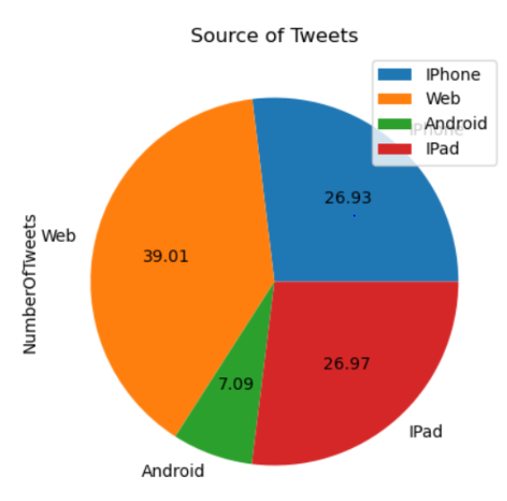
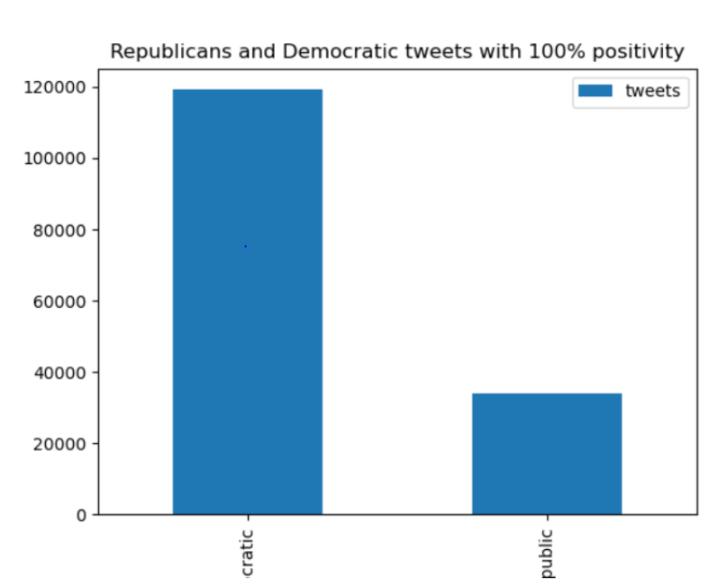
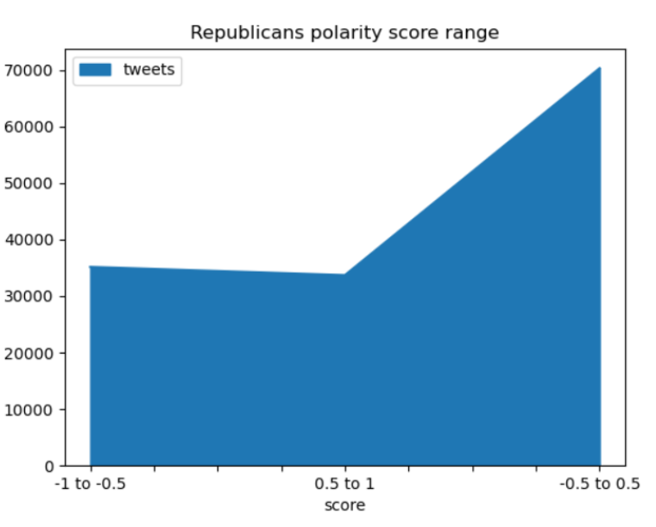
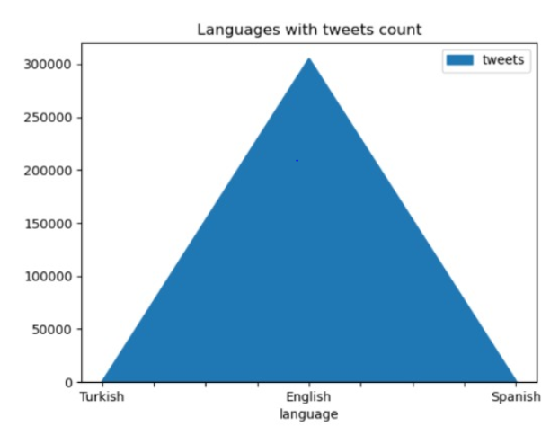
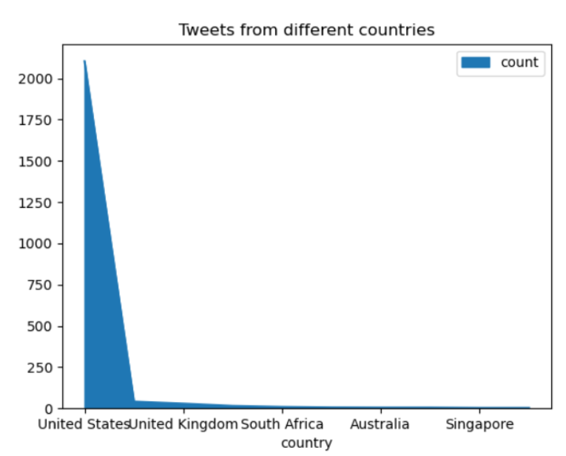
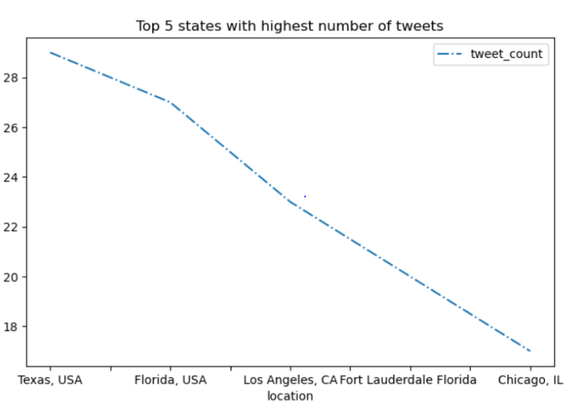
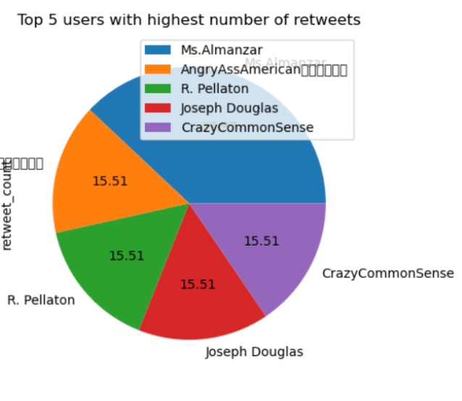
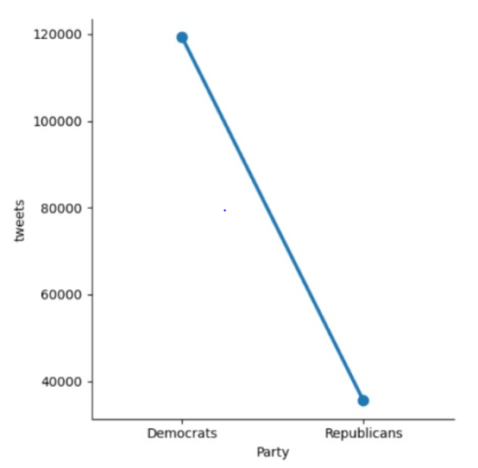
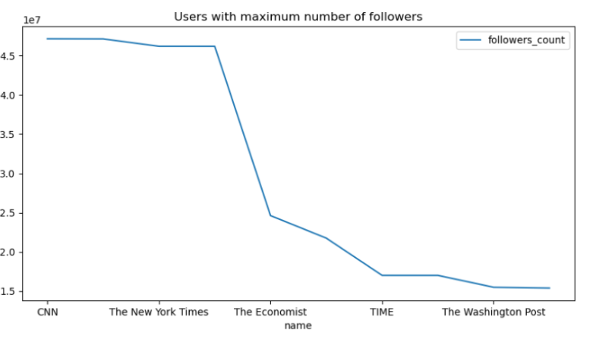
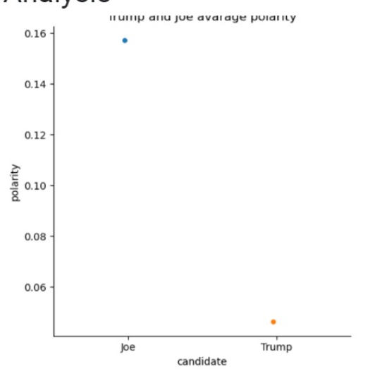
Twitter Data Analysis DEMOCRATICS v/s REPUBLICANS
Introduction
Technologies:
Python, Apache Spark, Mat-plot, Twitter, Hadoop
Conclusion:
We have collected the tweets with tags “Democratic Party, Republican Party, Democrats, Republican, GOP, Democratic, Republics”. We have analyzed and visualized the tweeter data about which party is mostly liked by people of USA, who has more supporters, who are the top users, who tweet more, Who has got more polarity ,user who gets more retweets, what is the mostly used device for tweeting .
Twitter is a 'microblogging' system that allows you to send and receive short posts called tweets. We have collected more than 300,000 tweets using Stream API. The Collected data is Analyzed and visually represented using Mat-plot visualization.
Tweets Originated from Different Sources
Tweets in favour of Democratic and Republic party
Tweets with Max Polarity score for Republicans
Result :
Highest number of tweets are tweeted from web and Android is the least used device.
Result :
Democratic party has more supporters compared to Republicans.
Result :
Most of the tweets for Republicans are with polarity score -0.5 to 0.5
Mostly used language of Tweets
Top 5 Countries who Tweets more
Tweets collected from Various Cities in USA
Result :
English is the most popular language for tweeting.
Result :
Twitter users in United States tweets more than any other country in the world
Result:
The graph shows the top users in USA are from Texas state .
Top 5 users with Highest number of Retweets
Subjective Tweets for Both the parties
User with maximun Number of Followers
Polarity of Tweets in favour of Trump and Joe
Result:
Top 5 users who has maximum number of Retweets
Result:
The number of Subjective tweets in Democratic Party are much higher than that of Republicans Party.
Result:
CNN gets most of the Retweets for their Tweets
Result:
Tweets collected in Favour of Joe has more polarity than Trump.

Slide 6

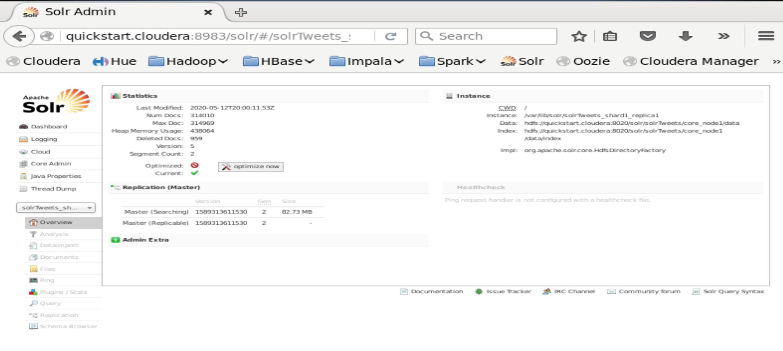
Solr
Cleaned tweets data
Created a csv file with necessary columns
Imported data into solr
Performed several queries

Slide 7
Solr Queries
1. Top 10 users with most followers
2. Top 10 users in the USA with most status count
3. Top 50 users in the USA with most friends
4. Users who tweeted about democrats
5. Uesrs who tweeted about republicans

Slide 8
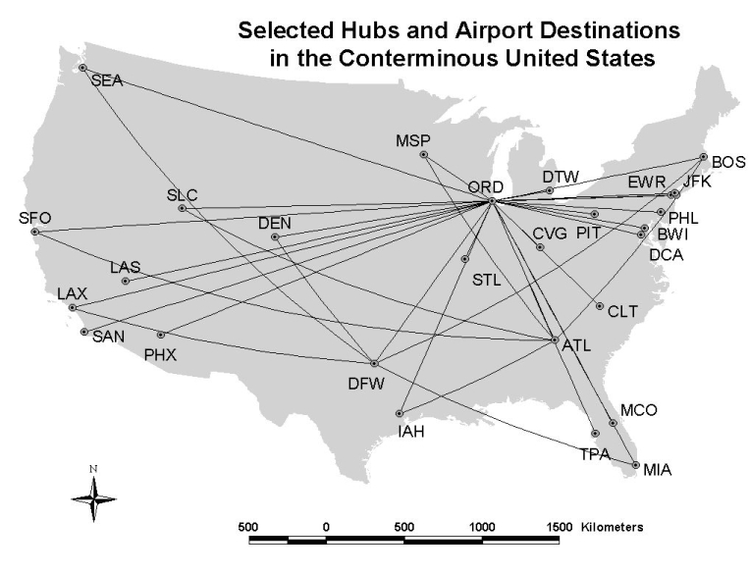
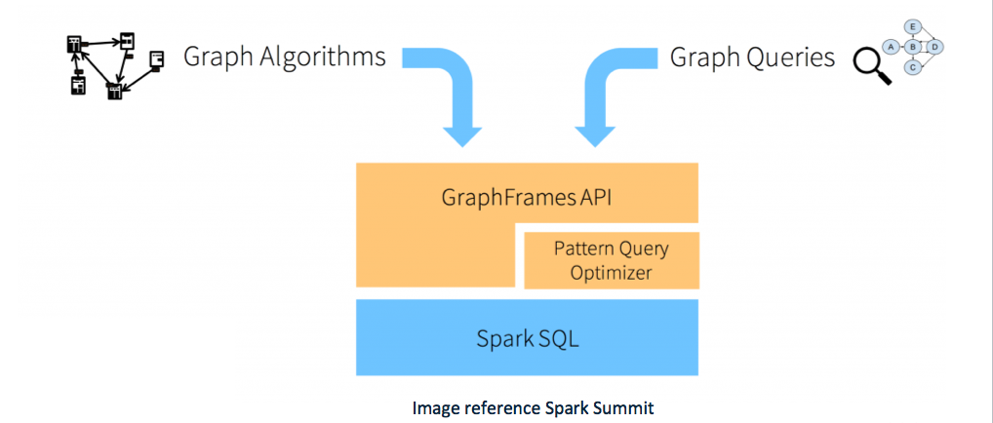
Graph frames
Created a graph frame on data frame created from twitter data.
Calculated indegree and outdegree for the graph
Calculated the number of triangles formed on the graph frame.
Calculated page ran using the graphframe.
Stored the created graphs in to parquet file.
Generated labels based on the “id” column, we can use these labels for classification purposes in Machine Learning.

Slide 9
Conclusion
Collected Twitter data using hashtags #Democrats, #Republicans and loaded into Hadoop and ran hive queries to get information on particular topic, exported tweets file to solar and queried using it, implemented sentimental analysis, built data frames on the data, queried using spark sql, created graphs on the data frames and implemented various operations using Graph frames.

